Slide 1
Single Page Application with AngularJS
Paulo Ito

Slide 2
Concept
A single-page application (SPA), is a web application or web site that fits on a single web page with the goal of providing a more fluid user experience akin to a desktop application [Wikipedia].
Single-Page Applications (SPAs) are Web apps that load a single HTML page and dynamically update that page as the user interacts with the app [Mike Wasson msdn].

Slide 3
Advantanges
Fluid transitions between pages.
Reduce load on your server.

Slide 4
Disadvantages
Javascript enable.
Client with enogh resources to run cliente javascripts.

Slide 5
How to Implement
JavaScript frameworks
AngularJS
Ember.js
Meteor.js
Knockout.js
AJAX
Websockets
Browser plugins
Silverlight.
Flash.
Java applets.

Slide 6
AngularJS
Created and maintained by Google.
SPA library.
Extend HTML vocabular.
Easy Data Binding: Two way Data Binding.
Reusable components.
MVC/MVVM Design Patterns.
Dependency Injection.
Unit Testing.
Routing.
Templating.

Slide 7
Key components
Dependency Injection.
Controllers.
Models.
Services.
Directives.
Modules.
Filters.
Factories.
Scope.
Templates
Routes.
Animations.
Data Binding.
Testings.

Slide 8
Routing
Hash based.
http://mydomain.com/#/Home
http://mydomain.com/#/Dashboard
http://mydomain.com/#/Admin

Slide 9
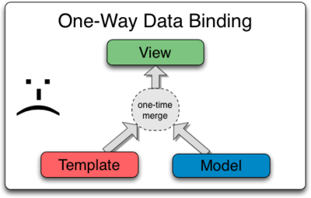
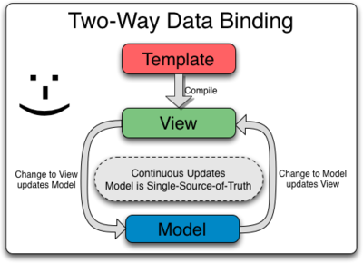
Two way Data Binding

Slide 10
DEMO

Slide 11
References
[Wikipedia] - http://en.wikipedia.org/wiki/Single-page_application
[Mike Wasson] - https://msdn.microsoft.com/en-us/magazine/dn463786.aspx
https://angularjs.org/
http://www.harbinger-systems.com/insights/webinar/benefits-of-developing-single-page-web-applications-using-angularjs

